Slide 1


Employee’s Productivity in the Garment Industry
Analysis
15/12/2023
Gracious Anonymous

Slide 2
Goals
Analyze data about employee’s productivity
Create models to predict productivity based on provided data
Define main factors contributing to productivity

Slide 3
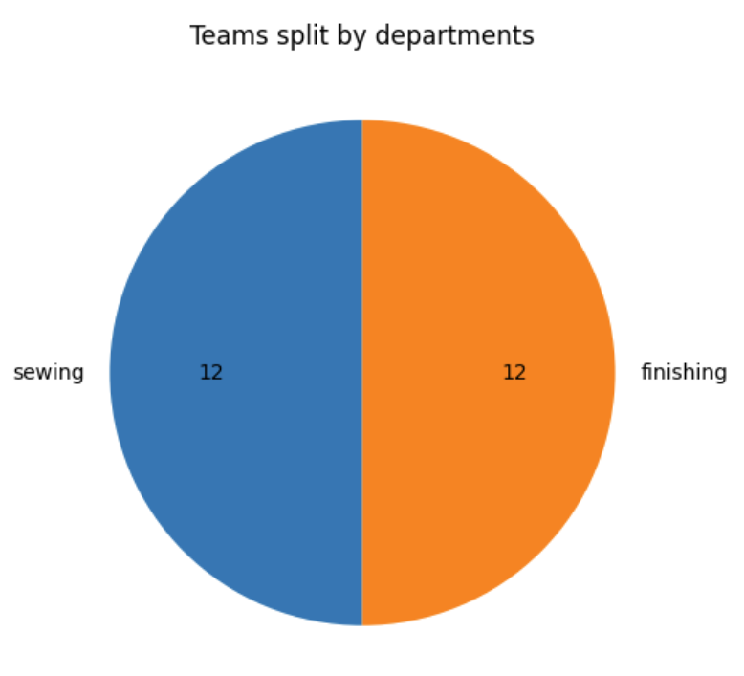
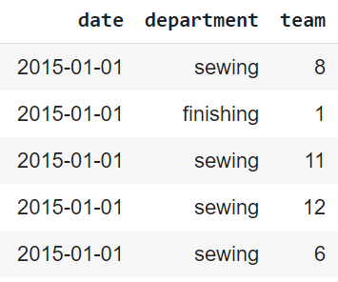
Data structure
Time period: 01.01.2015–11.03.2015
Each team works several shifts through given period.
For given period, teams carried out 1197 working shifts in total.

Slide 4
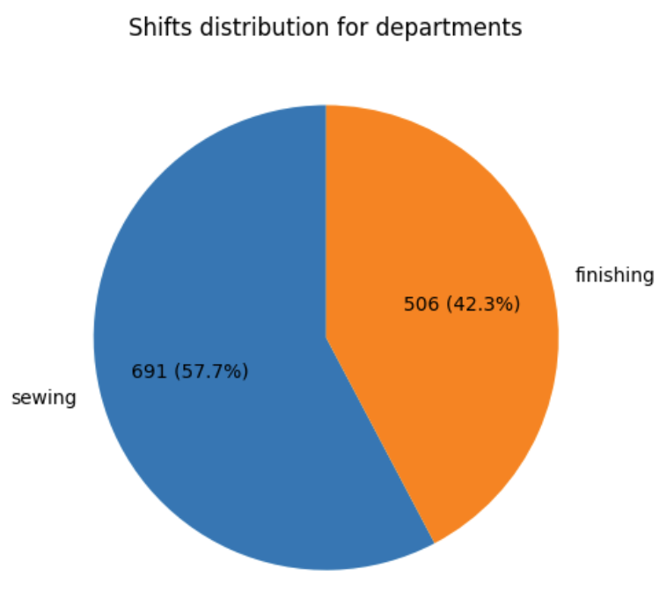
Data structure

Slide 5
Data structure
Other features:
Day & quarter: details of date
Number of workers and Standard Minute Value (SMV): highly correlated
Number of style changes
WIP, work in progress, amount of unfinished products
Overtime
Idle time & idle men, characteristics of work interruption
Incentive, financial reward
Target features:
Targeted productivity, range 0.7-0.8
Actual productivity: 0.2-1.12

Slide 6
Goal & target definition
The goal is to classify productivity of shifts in the categories:
low;
medium low;
medium high;
high
Classes to original data to be assigned on basis of productivity delta:
productivity delta = actual productivity - targeted productivity

Slide 7
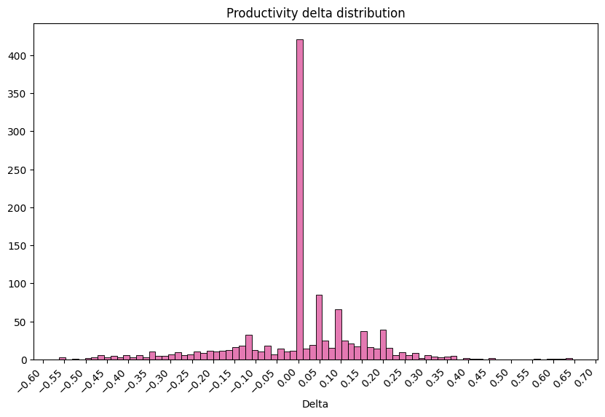
Goal & target definition

Slide 8
Goal & target definition
25% below Q1 - low productivity
25% between Q1-Q2 - medium low productivity
25% between Q2-Q3 - medium high productivity
25% above Q3 - high productivity
Q1 -0.9556%
Q2 0.0505%
Q3 9.9111%
Use quartiles?
productivity delta = 0 means, that the targeted productivity is reached
0 must divide low and high

Slide 9
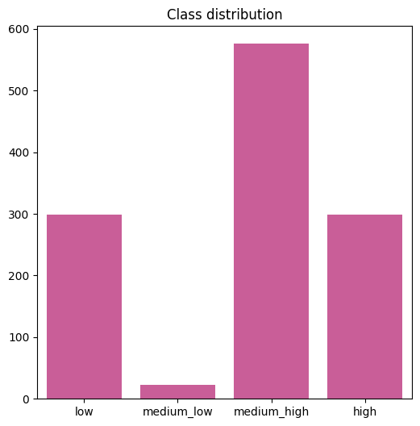
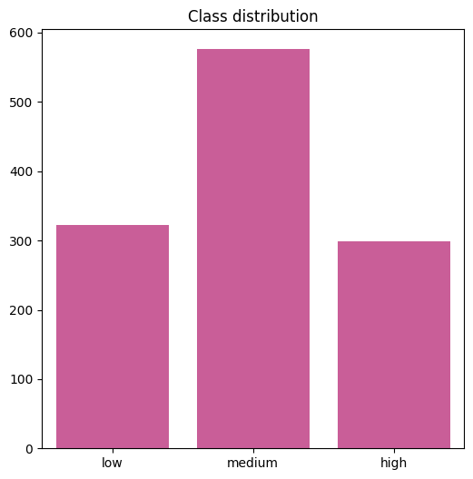
Goal & target definition
Merge low classes
Q2: 0.0505% -> 0%

Slide 10
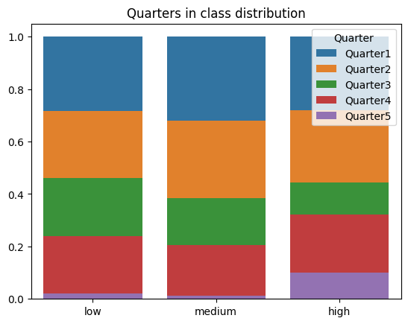
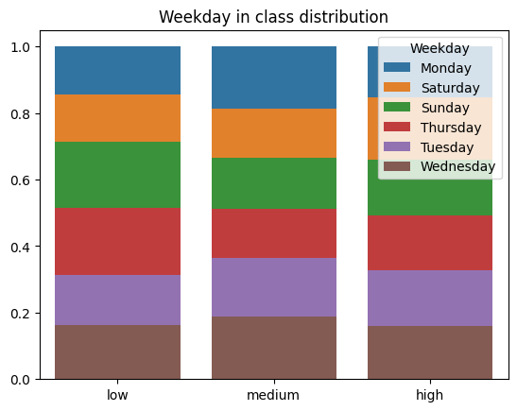
Exploratory analysis

Slide 11
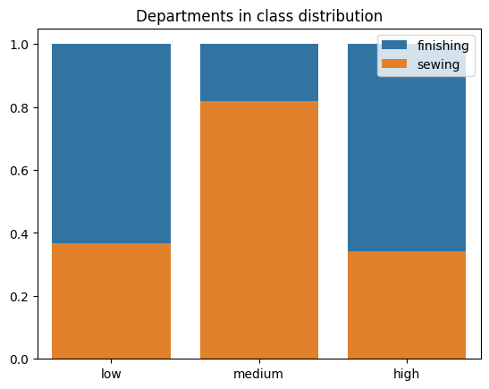
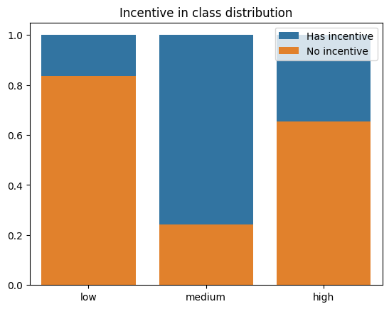
Exploratory analysis

Slide 12
Hypothesis
Features to have significant influence:
incentive;
department;
number of workers;
WIP
Features to have little influence:
day & quarter;
number of style changes;
idle men and idle time

Slide 13
Preprocessing & features engineering
Features to exclude:
targeted_productivity, actual_productivity - target value is derived from them
team, date - part of identifier
SVM (correlation with N. of workers is 0.91)
Features to one-hot-encode (categorical):
quarter;
day;
department
For scaling, standardization is chosen - a lot of outliers present.
Target is encoded ordinally.
10 features
20 features

Slide 14
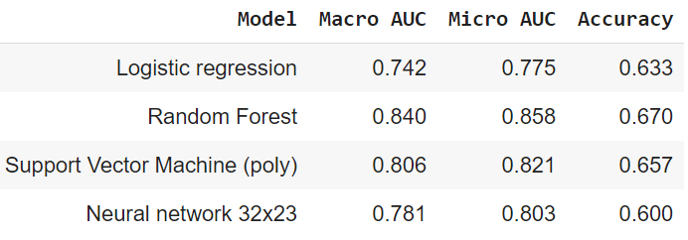
Predictive models
GridSearch was used to find optimal parameters.
Due to class imbalance, AUCs are better metrics to assess a model performance.

Slide 15
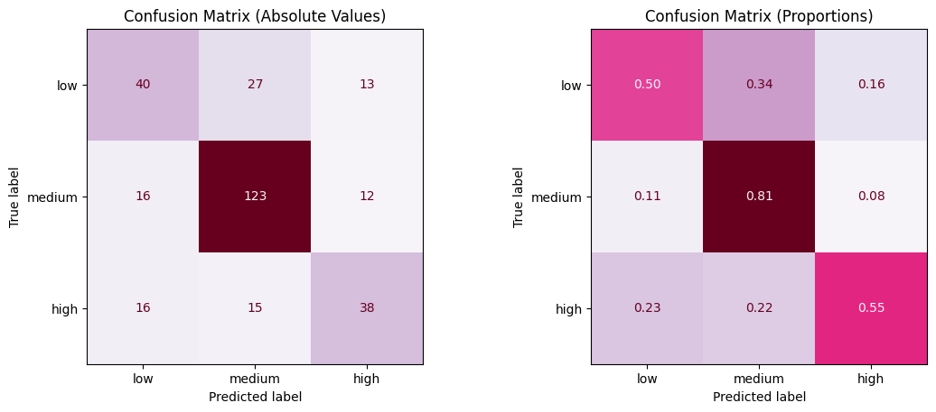
Predictive models: the best model

Slide 16
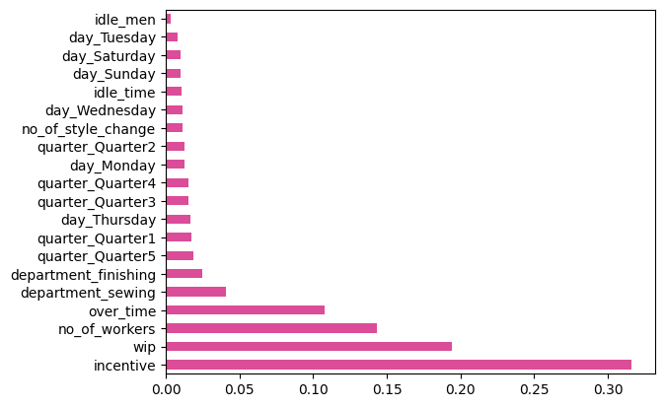
Features interpretation: random forest

Slide 17
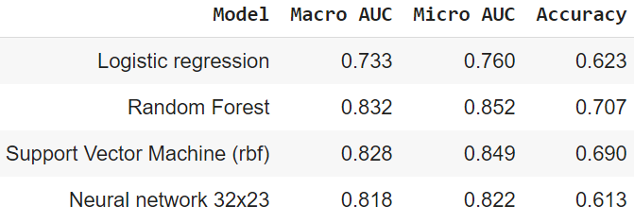
Predictive models: less features
Features for day and quarter do not have large impact in the best model. They were removed, and new models have following metrics:
Random Forest AUC did not change much, but minority classes are now predicted better.

Slide 18
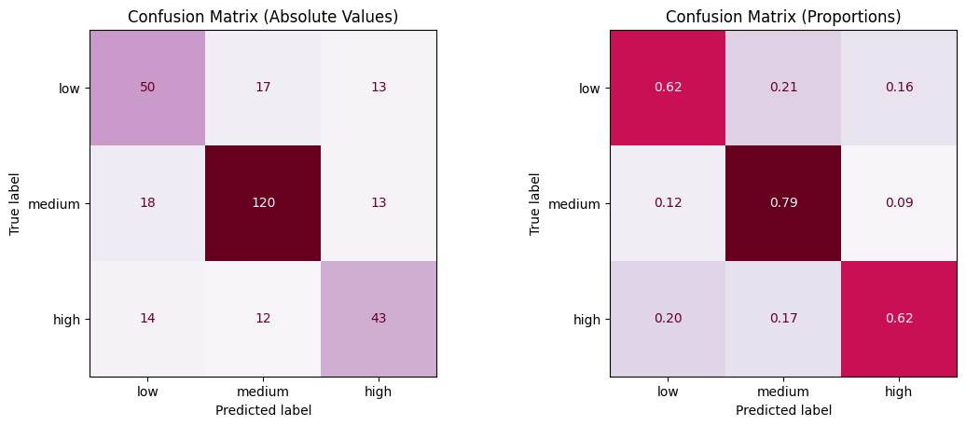
Predictive models: less features, the best model

Slide 19
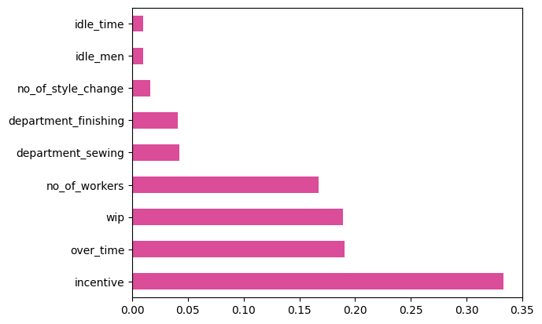
Features interpretation: improved random forest

Slide 20
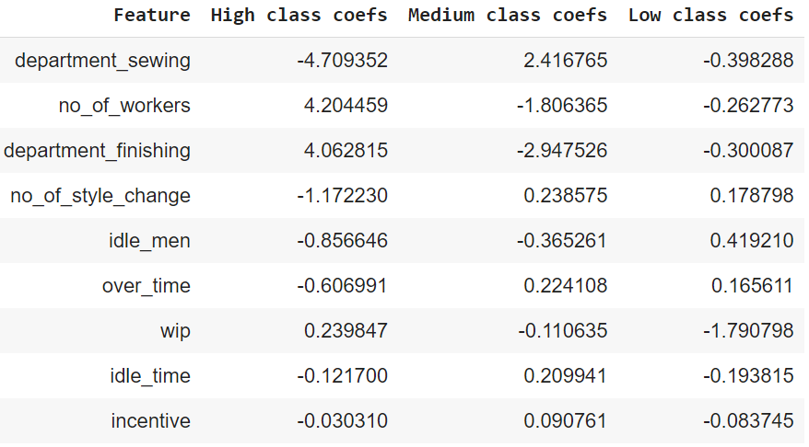
Features interpretation: logistic regression

Slide 21
Conclusion
Incentive, WIP, number of workers, overtime and department influence productivity the most;
Day & quarter have little influence on productivity and even harm model’s performance, number of style changes, idle men and idle time are slightly more impactful;
More insights can be drawn from more thorough exploration of feature importances & weights;
Trying out different ensemble models in combination with parametric models;
Bigger dataset might be used for capturing more data patterns;
Possibly analysis from teams aspect can bring more interesting insights.

Slide 22

Thanks for your attention!

